Slide 1

Welcome to CAVC
Entry 1 students
Cardiff & Vale College
2024-2025

Slide 2

Welcome all ESOL Students

Slide 3
Induction
This week you will…….
Learn how to log on to your college email
Learn how to use Teams
Get to know each other
Sign your learner agreement
Complete your learner profile
Be given your timetable, exam dates, important information

Slide 4
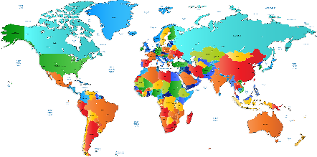


Icebreaker & Introductions
Tell me 4 things:
Your name …….
Where you come from
One thing you like
One thing you don’t like

Slide 5


English only please:
Respect other students
1 Canal Parade
Dumballs Road Cardiff CF10 5BF
Tel: 02920 250 250
ESOL: 02920 250 263

Slide 7


Learn how to log onto your College Email
How to log onto Office 365

Slide 8

Learn how to log on and use Teams
How to log onto Teams

Slide 9

Induction Period
You may complete a test to check your English level. Your teachers will help you to work on your speaking and listening, reading and writing.

Slide 10




ESOL 17-hours
You will:
Study face to face
study online
And complete regular homework.

Slide 11




ESOL 17-hours
You will study:
Integrated skills:
speaking
listening
reading
writing
Cultural topical & grammar
.

Slide 12

ESOL 17-hours
There will also be:
Personal targets to work towards
Regular progress tests
Final exams - Ascentis or Agored
Provisional Dates- these are not definite!
Speaking and listening WC 18th March 2024
Reading WC 17th June 2024
Writing WC 10th June 2024

Slide 13
Icebreaker
Speaking activity
Talking about topics that interest you
https://eslgames.com/the-expert-game/
Wordwall
Guess the sound quiz
Vehicle sounds
Name that household sound
OR

Slide 14
Your Timetable INSERT YOUR TIMETABLE HERE
weekly timetable template.docx

Slide 15

The first 6 weeks of your course will be a trial period
You are expected to:
Work hard
Be on time
Attend all classes
Complete all homework on time
Take all exams entered
Be respectful to others at all times
You will sign a Form learner agreement, to agree to these.
If your tutor has concerns, he/she will speak to you and your Head of Department.
You need to do as expected to be entered for the exams.

Slide 16


Complete your Learner Agreement
ESOL LEARNER AGREEMENT 2023.docx

Slide 17

Complete your Learner Profile
Learner Information and TT Templates
(choose template from here)
Computer Skills Questionnaire .docx

Slide 18
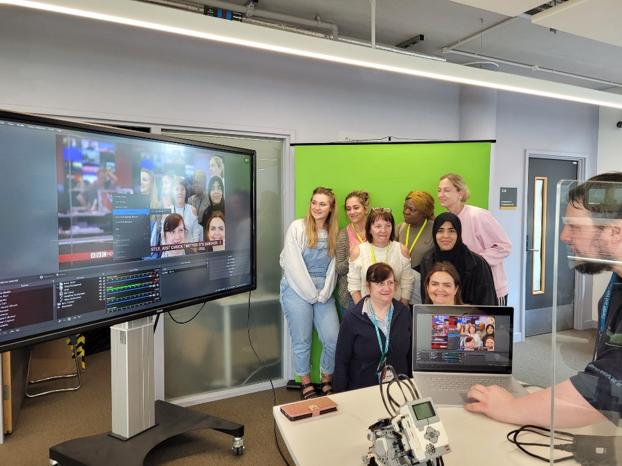
Success Centre
The Success Centre and Skills Centre are open every day.
The Success Centre is open Monday to Thursday from 8:30 – 5 and on Friday 8:30 – 4.
If you would like extra help with your
English/Maths/IT, ask your teacher.

Slide 19

Your ESOL tutor:
Tutor:
Email:
You can also contact me on Teams private chat

Slide 20

Any Questions?

